Slide 1
Art as an Archive of Memory
PECHA KUCHA STYLE PRESENTATION
By: Melissini Motiti 14/05/2025
Notes:
Hi guys, so my project is still in the works but the aim is to explore how art can often times serve as an archive—holding personal and cultural memories, especially within an intercultural context. A memory that bridges time- culture and people.

Slide 2
Notes:
Art doesn’t just express beauty or aesthetics—it also holds experiences. As ive realized even more during my time with MAIP, artists use their practice to process memory, identity, and change…Or in other words their positionality and interculturality.

Slide 3
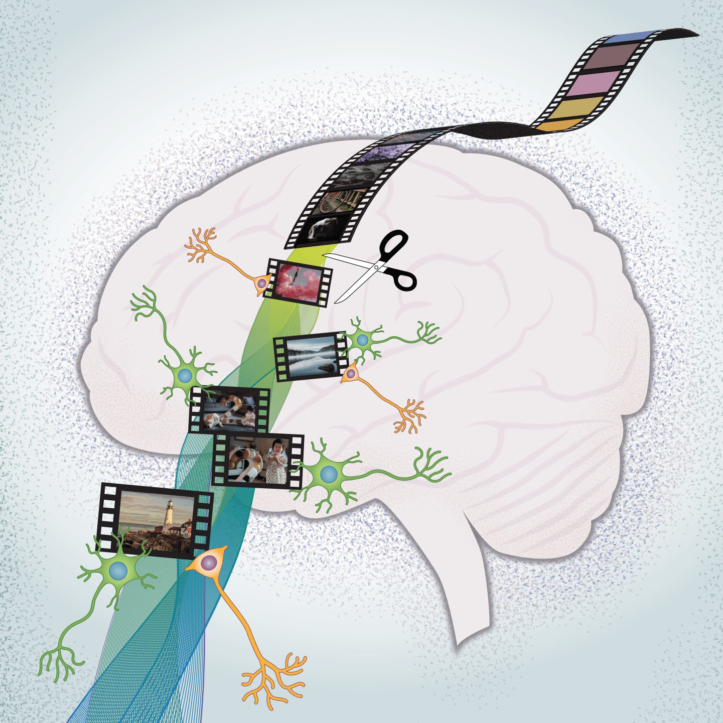
Future Directions
How this project can evolve: expanding the concept of memory in art, experimenting with other media, and involving community-based feedback.
Possible exhibitions or future research on the intersection of memory, culture, and identity in art.
Notes:
My thesis aims to treat positionality, experience and memory—like storytelling and personal heritage—as valuable knowledge, worthy of reflection and research.

Slide 4
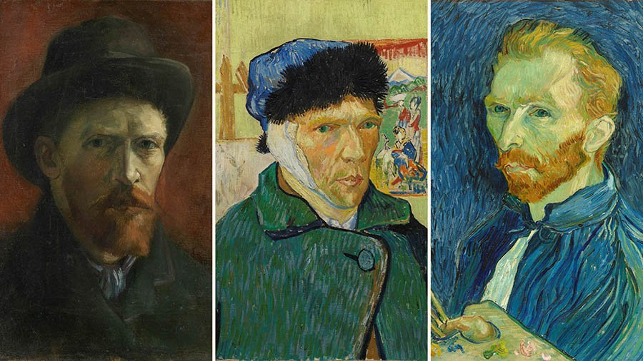
Notes:
When we think of archives, we picture libraries or museums. But memory can be held in less formal ways—in marks, gestures, and stories passed down. Art becomes an alternative archive—emotional, intuitive, and lived.

Slide 5
Notes:
Cultural memory isn’t just history—it’s lived experience. Humans translate this through visual language: patterns, symbols, materials. Ive included a frivolite in this slide because it is something we have discussed all together and a very obvious traditional pattern that Cypriots consider extremely important to the country’s aesthetics.

Slide 6
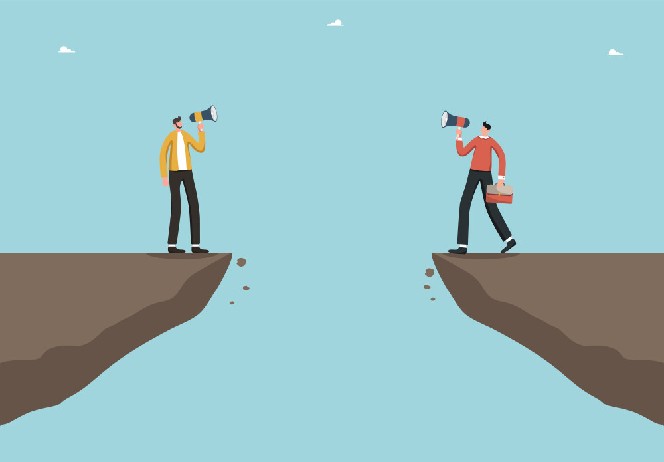
Notes:
In intercultural contexts, memory helps bridge identities. Artists often carry stories from more than one place or culture, so Art becomes a space where those in-between experiences can be preserved and shared, which is something I believe we as a course deeply relate to.

Slide 7
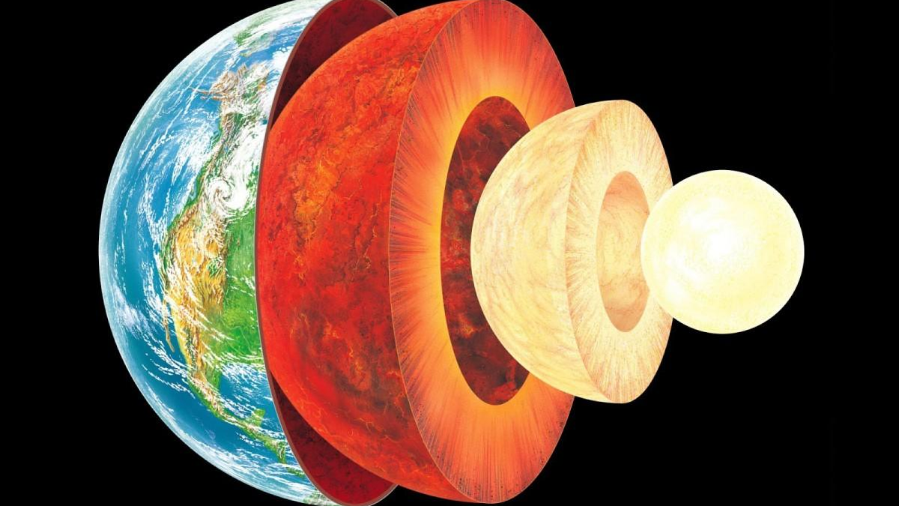
Notes:
Unlike words, images move across language and borders. A single painting or animation can carry fragments of a homeland, a relationship, a generation’s silence. This is the power of visual storytelling.

Slide 8
Notes:
As an example for what I mean, think of artworks that use lovers, pets, or people the artist surrounds themselves with as inspiration. These visual languages become vessels for memory—where everyday items are transformed into symbols of emotion and connection.

Slide 9
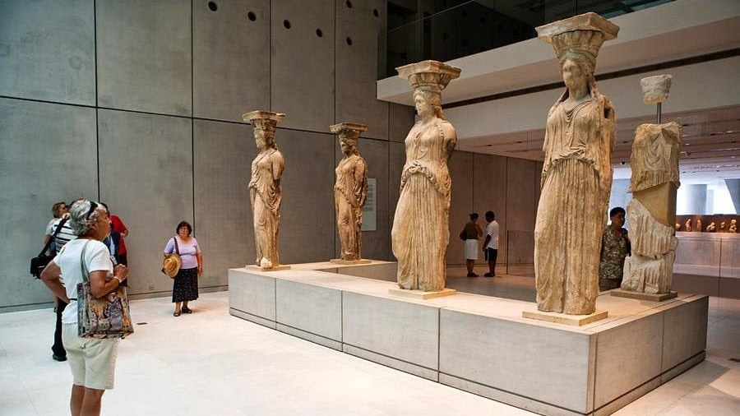
Artworks That Reflect Memory
Example: Christian Boltanski’s work, which often reflects loss, memory, and identity.Salcedo’s installations that preserve the memory of trauma.
Notes:
UNESCO defines intangible heritage as customs, traditions, and expressions passed through generations. Art can help make this intangible memory visible—especially when the original form, like oral storytelling, fades.

Slide 10
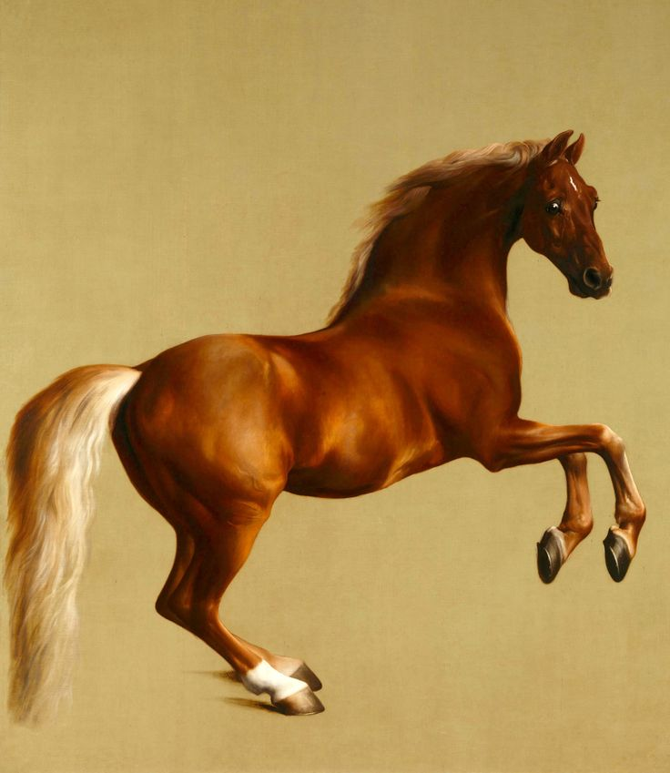
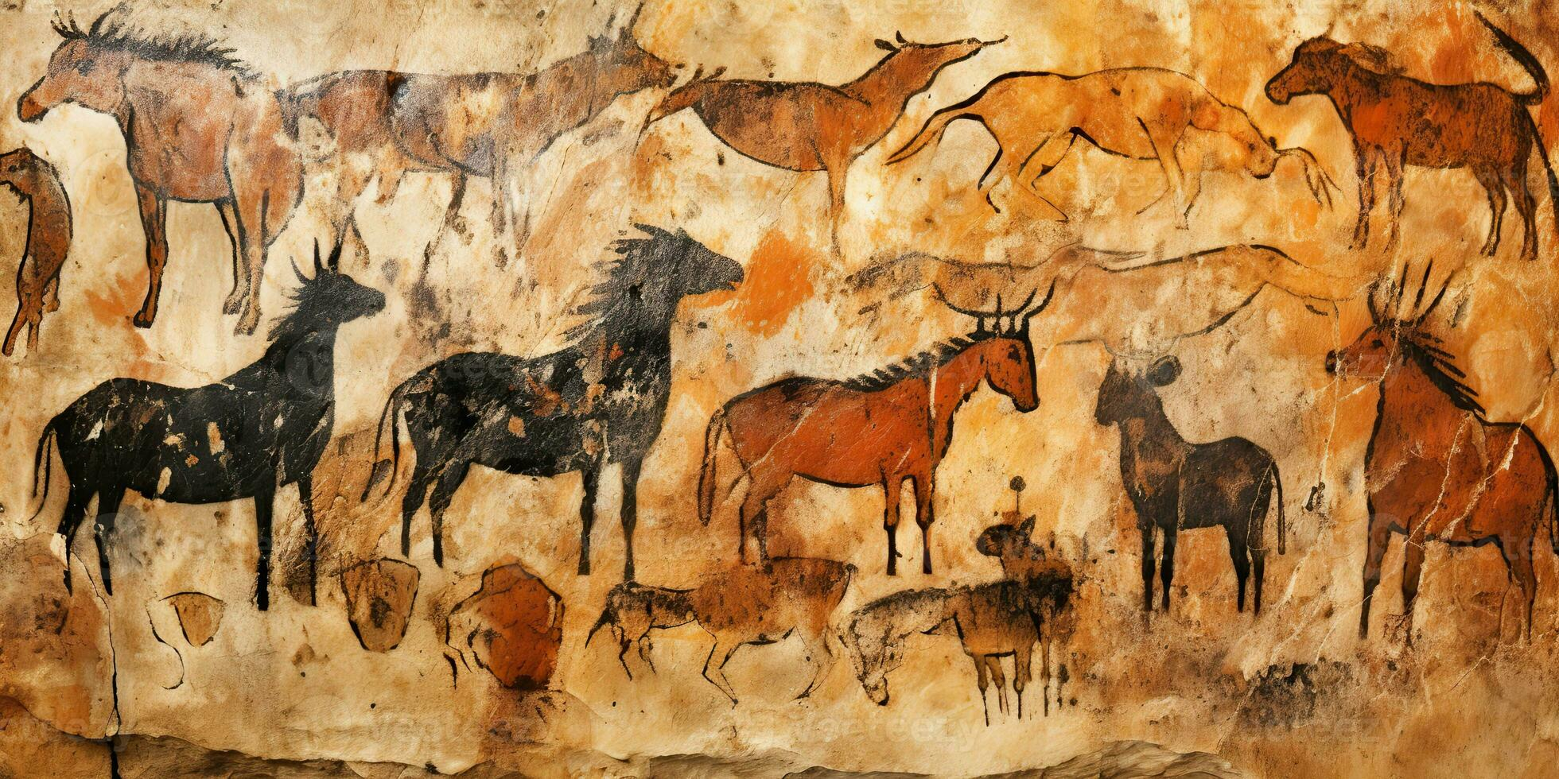
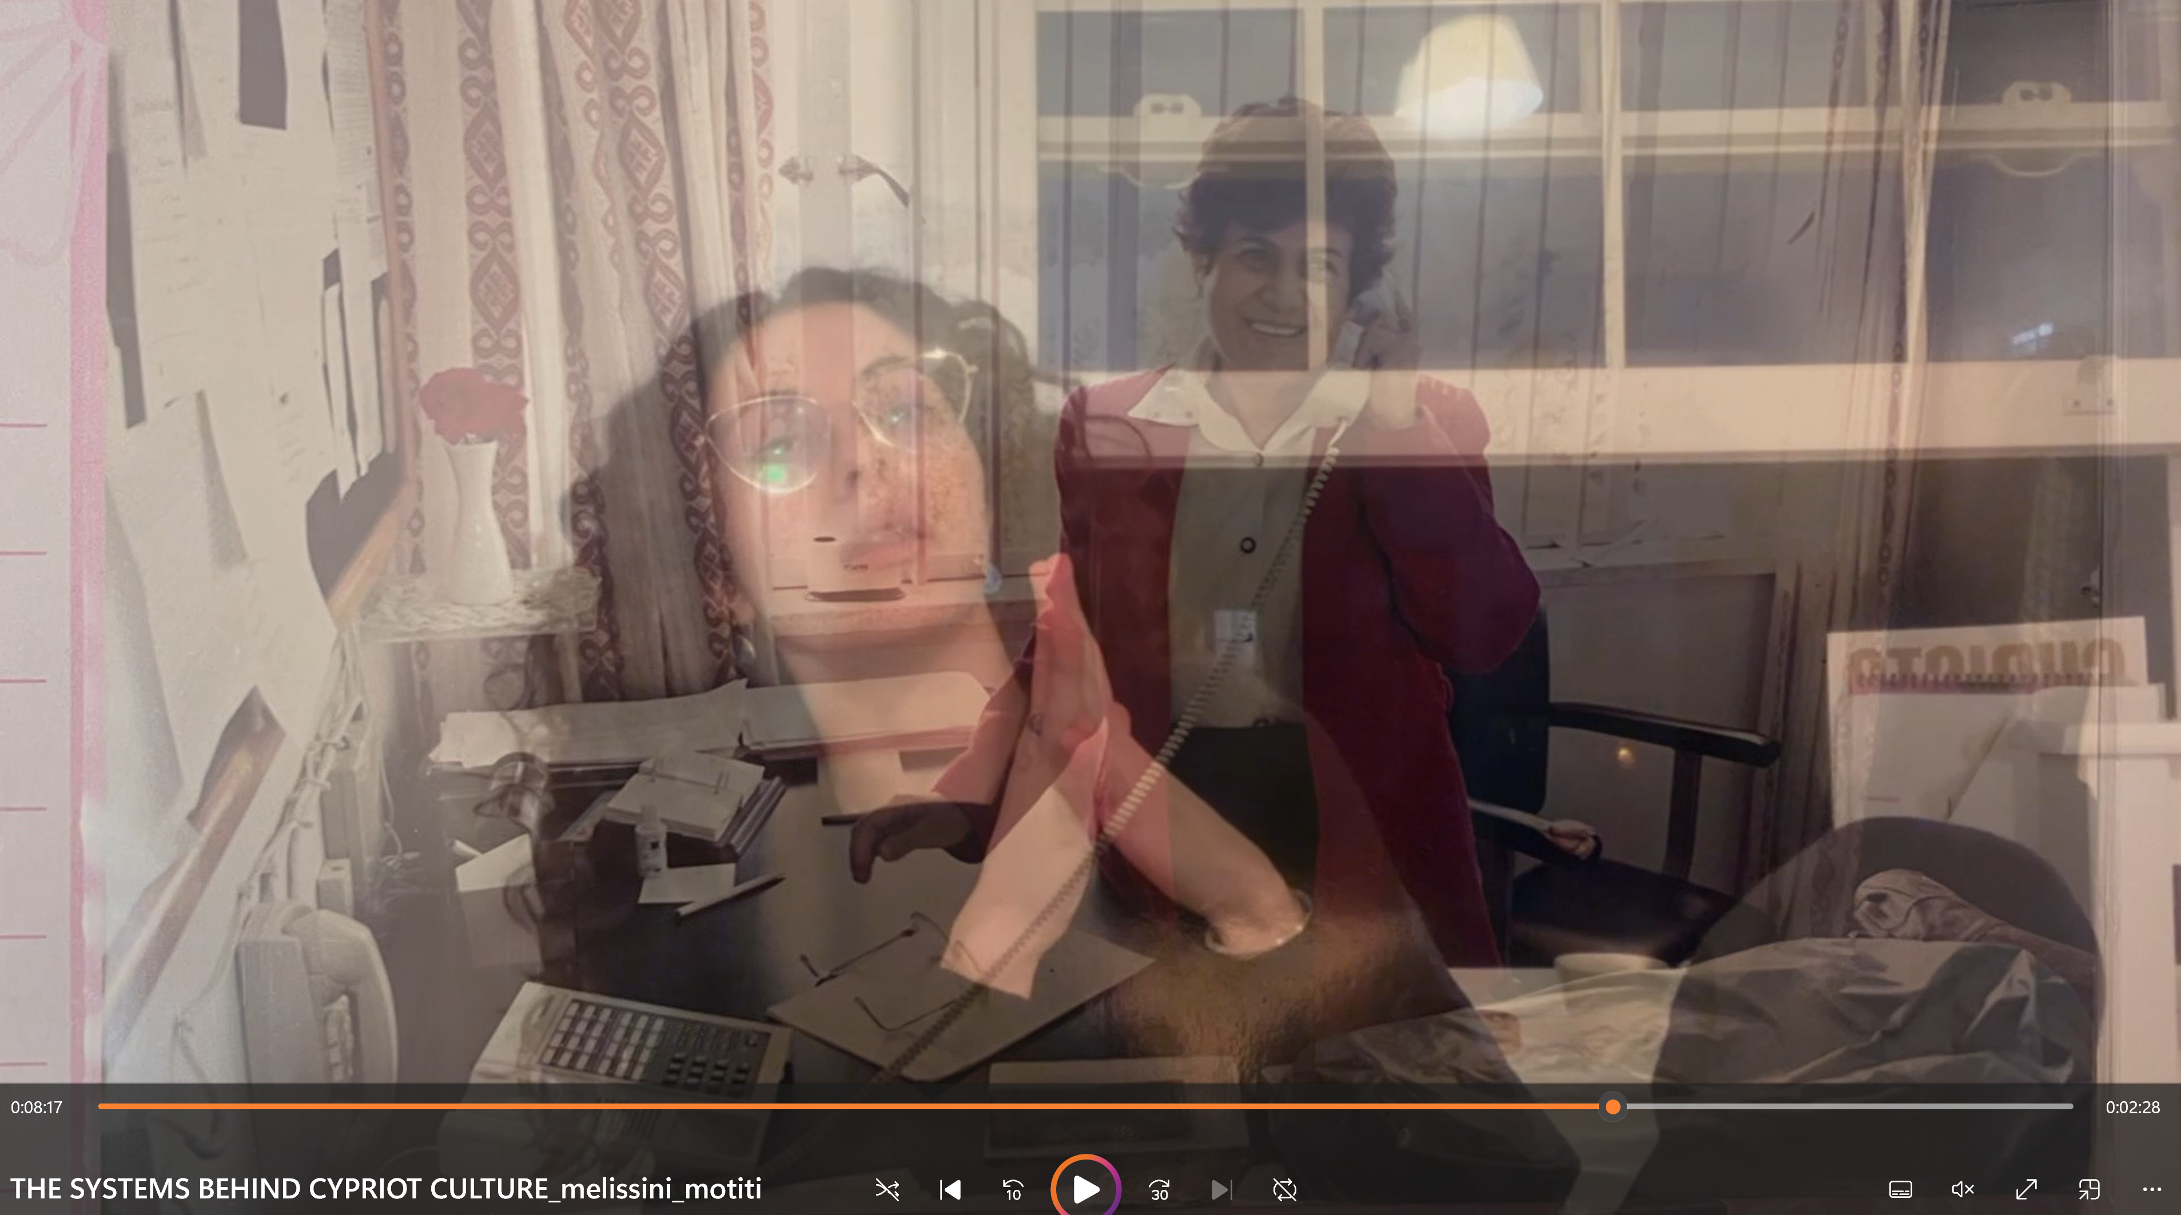
Notes:
as artists we translate emotion, memory, and culture into visual form. we are cultural translators—our story or emotions live in our artwork, creating an emotional record for future viewers to access.
. My personal practice is largely about visualizing my culture and loved ones which is something that made me interested in this topic.

Slide 11
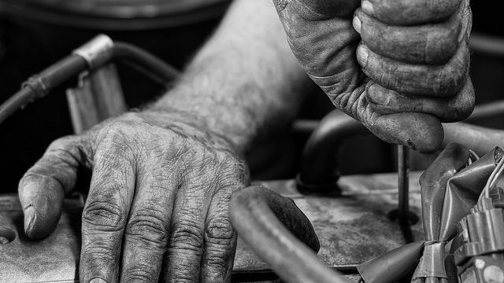
Notes:
In some works, artists embed traditions through texture, color, and form—like embroidery techniques or ritualistic gestures. These choices quietly carry cultural weight, communicating shared history without directly explaining it.

Slide 12
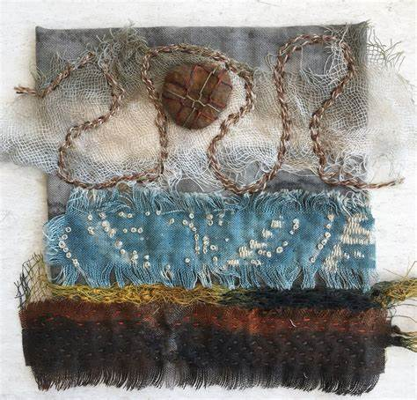
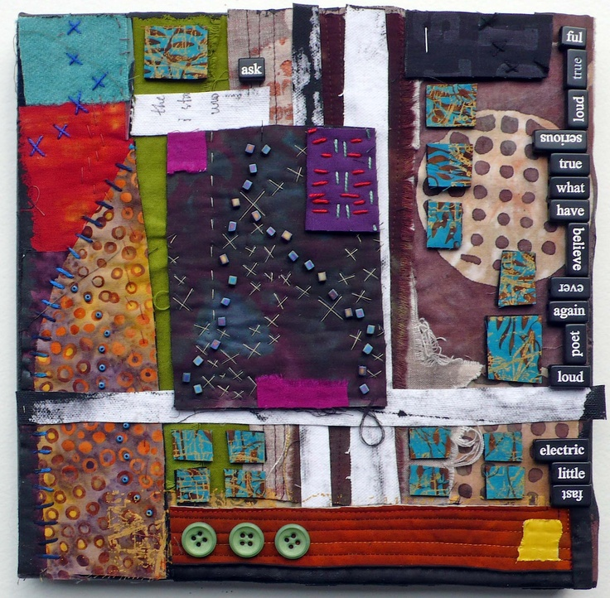
Notes:
Even materials carry memory—textiles, clay, photographs. Artists choose their medium not just for aesthetics, but because it resonates with cultural memory, with touch, with ancestry.
Art doesn’t just document events—it holds emotion.

Slide 13
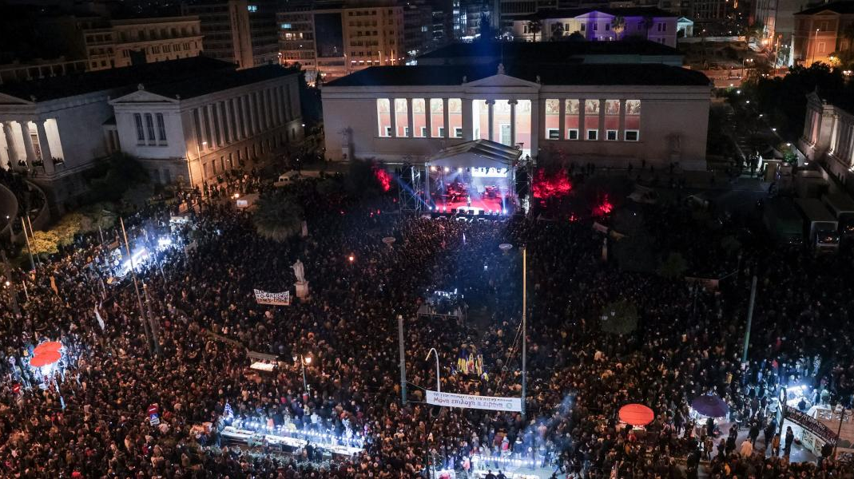
Notes:
Memory in art is often both personal and collective. One person’s story reflects many. Artists weave the private with the communal, allowing viewers to recognize themselves in unfamiliar stories.

Slide 14
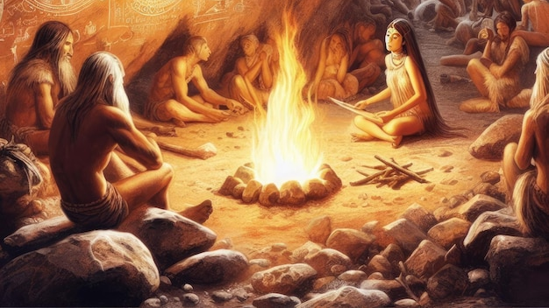
Notes:
Oral storytelling is one of the oldest forms of memory preservation. It has always been a way for the people to preserve their identity when written word was inaccessible due to class, status or lack of education. My research touches on how this tradition of storytelling often survives through the aid of visual art.

Slide 15
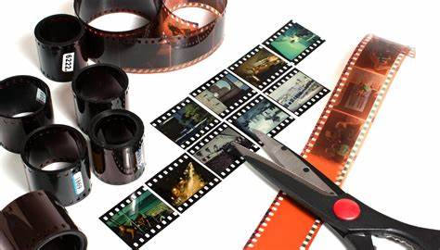
Notes:
My project will be grounded in research from memory studies, visual culture, and intercultural theory. I’ll also analyse case studies of artists who deal with themes of memory, storytelling, and heritage. It might be a written or a video essay or both. I will draft the text and decide as I go.

Slide 16
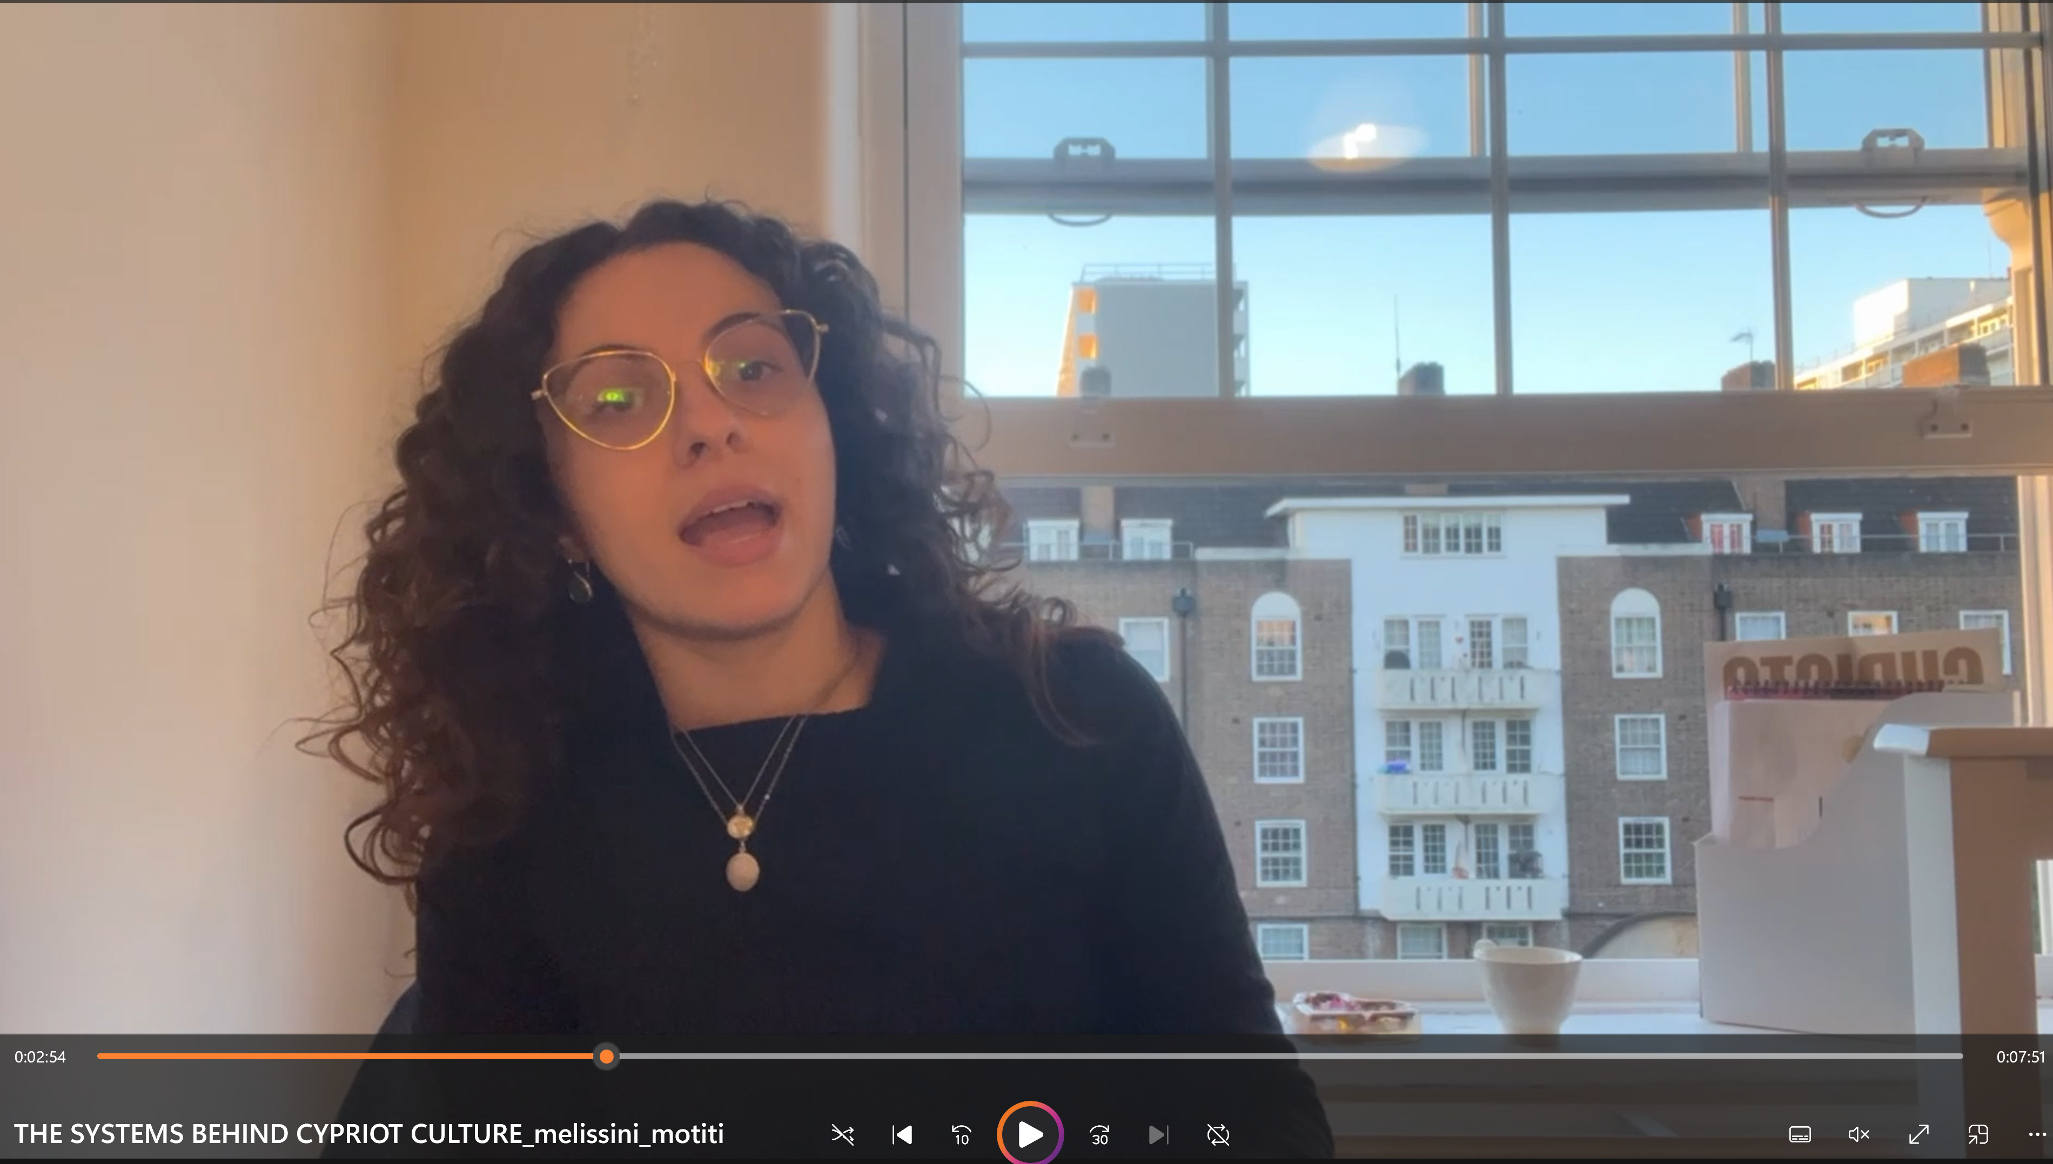
Notes:
I am using a screenshot from my unit 1 submission which I think i want to mimic for this thesis, IF I chose to go the video essay route, it will be a full circle moment and I do enjoy a process that allows for me to be a participant in my own research and project.

Slide 17
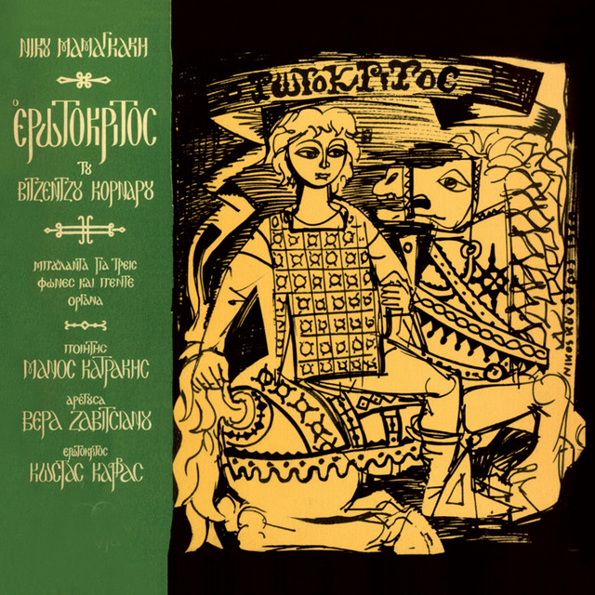
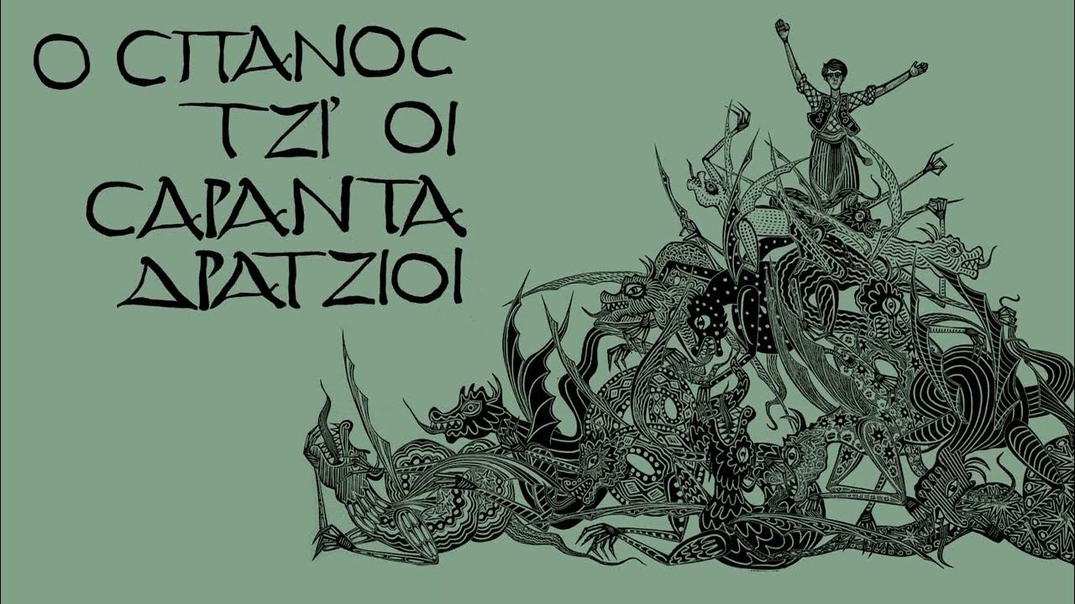
Notes:
“I’m including a small example of some work I will be doing parallel to my thesis. This work won’t drive the research, but I consider it a case study for my thesis as its themes are about how memory lives through art! Perfectly aligned with the topic.

Slide 18
Notes:
In this exhibition I am giving my own visual spin on a word of mouth- preserved folk tale, while taking inspiration from traditional visuals and aesthetics. I will also be collaborating with a musician who will turn this folk tale into a lyrical song.

Slide 19
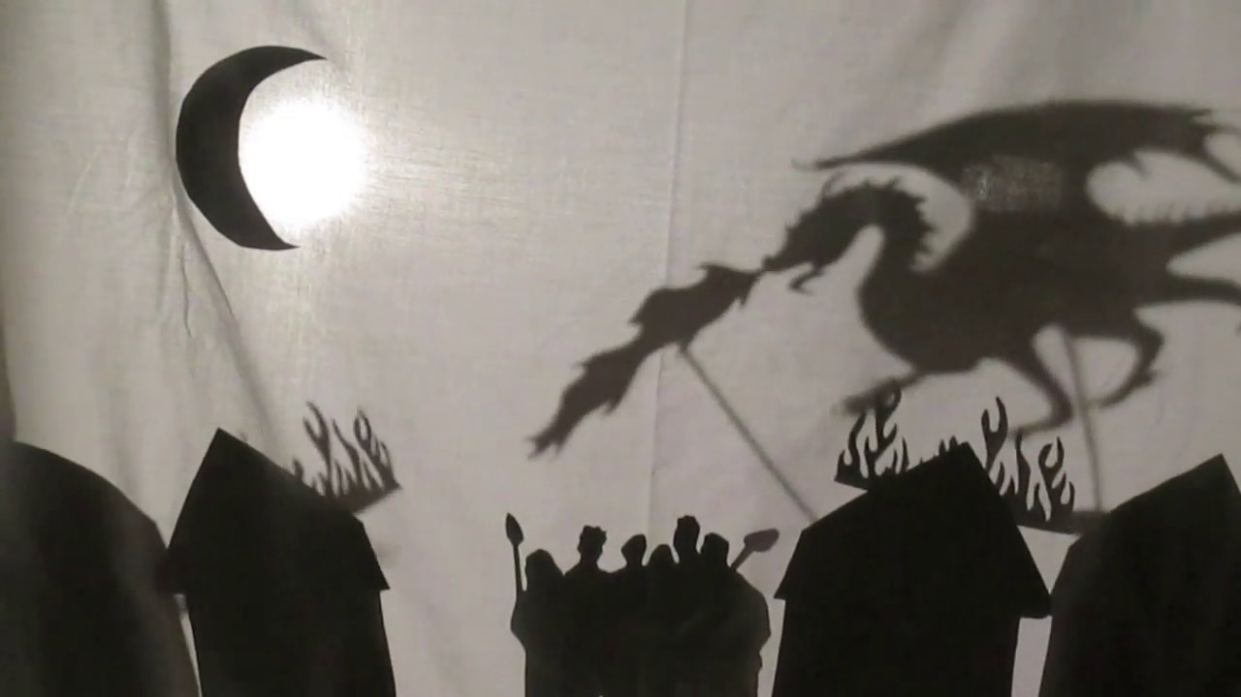
Notes:
This project urged me to think about how art captures what speech once held and how both music and visual art are used to preserve the stories, aesthetics and lifestyles of people through the ages and transport people to those times.

Slide 20
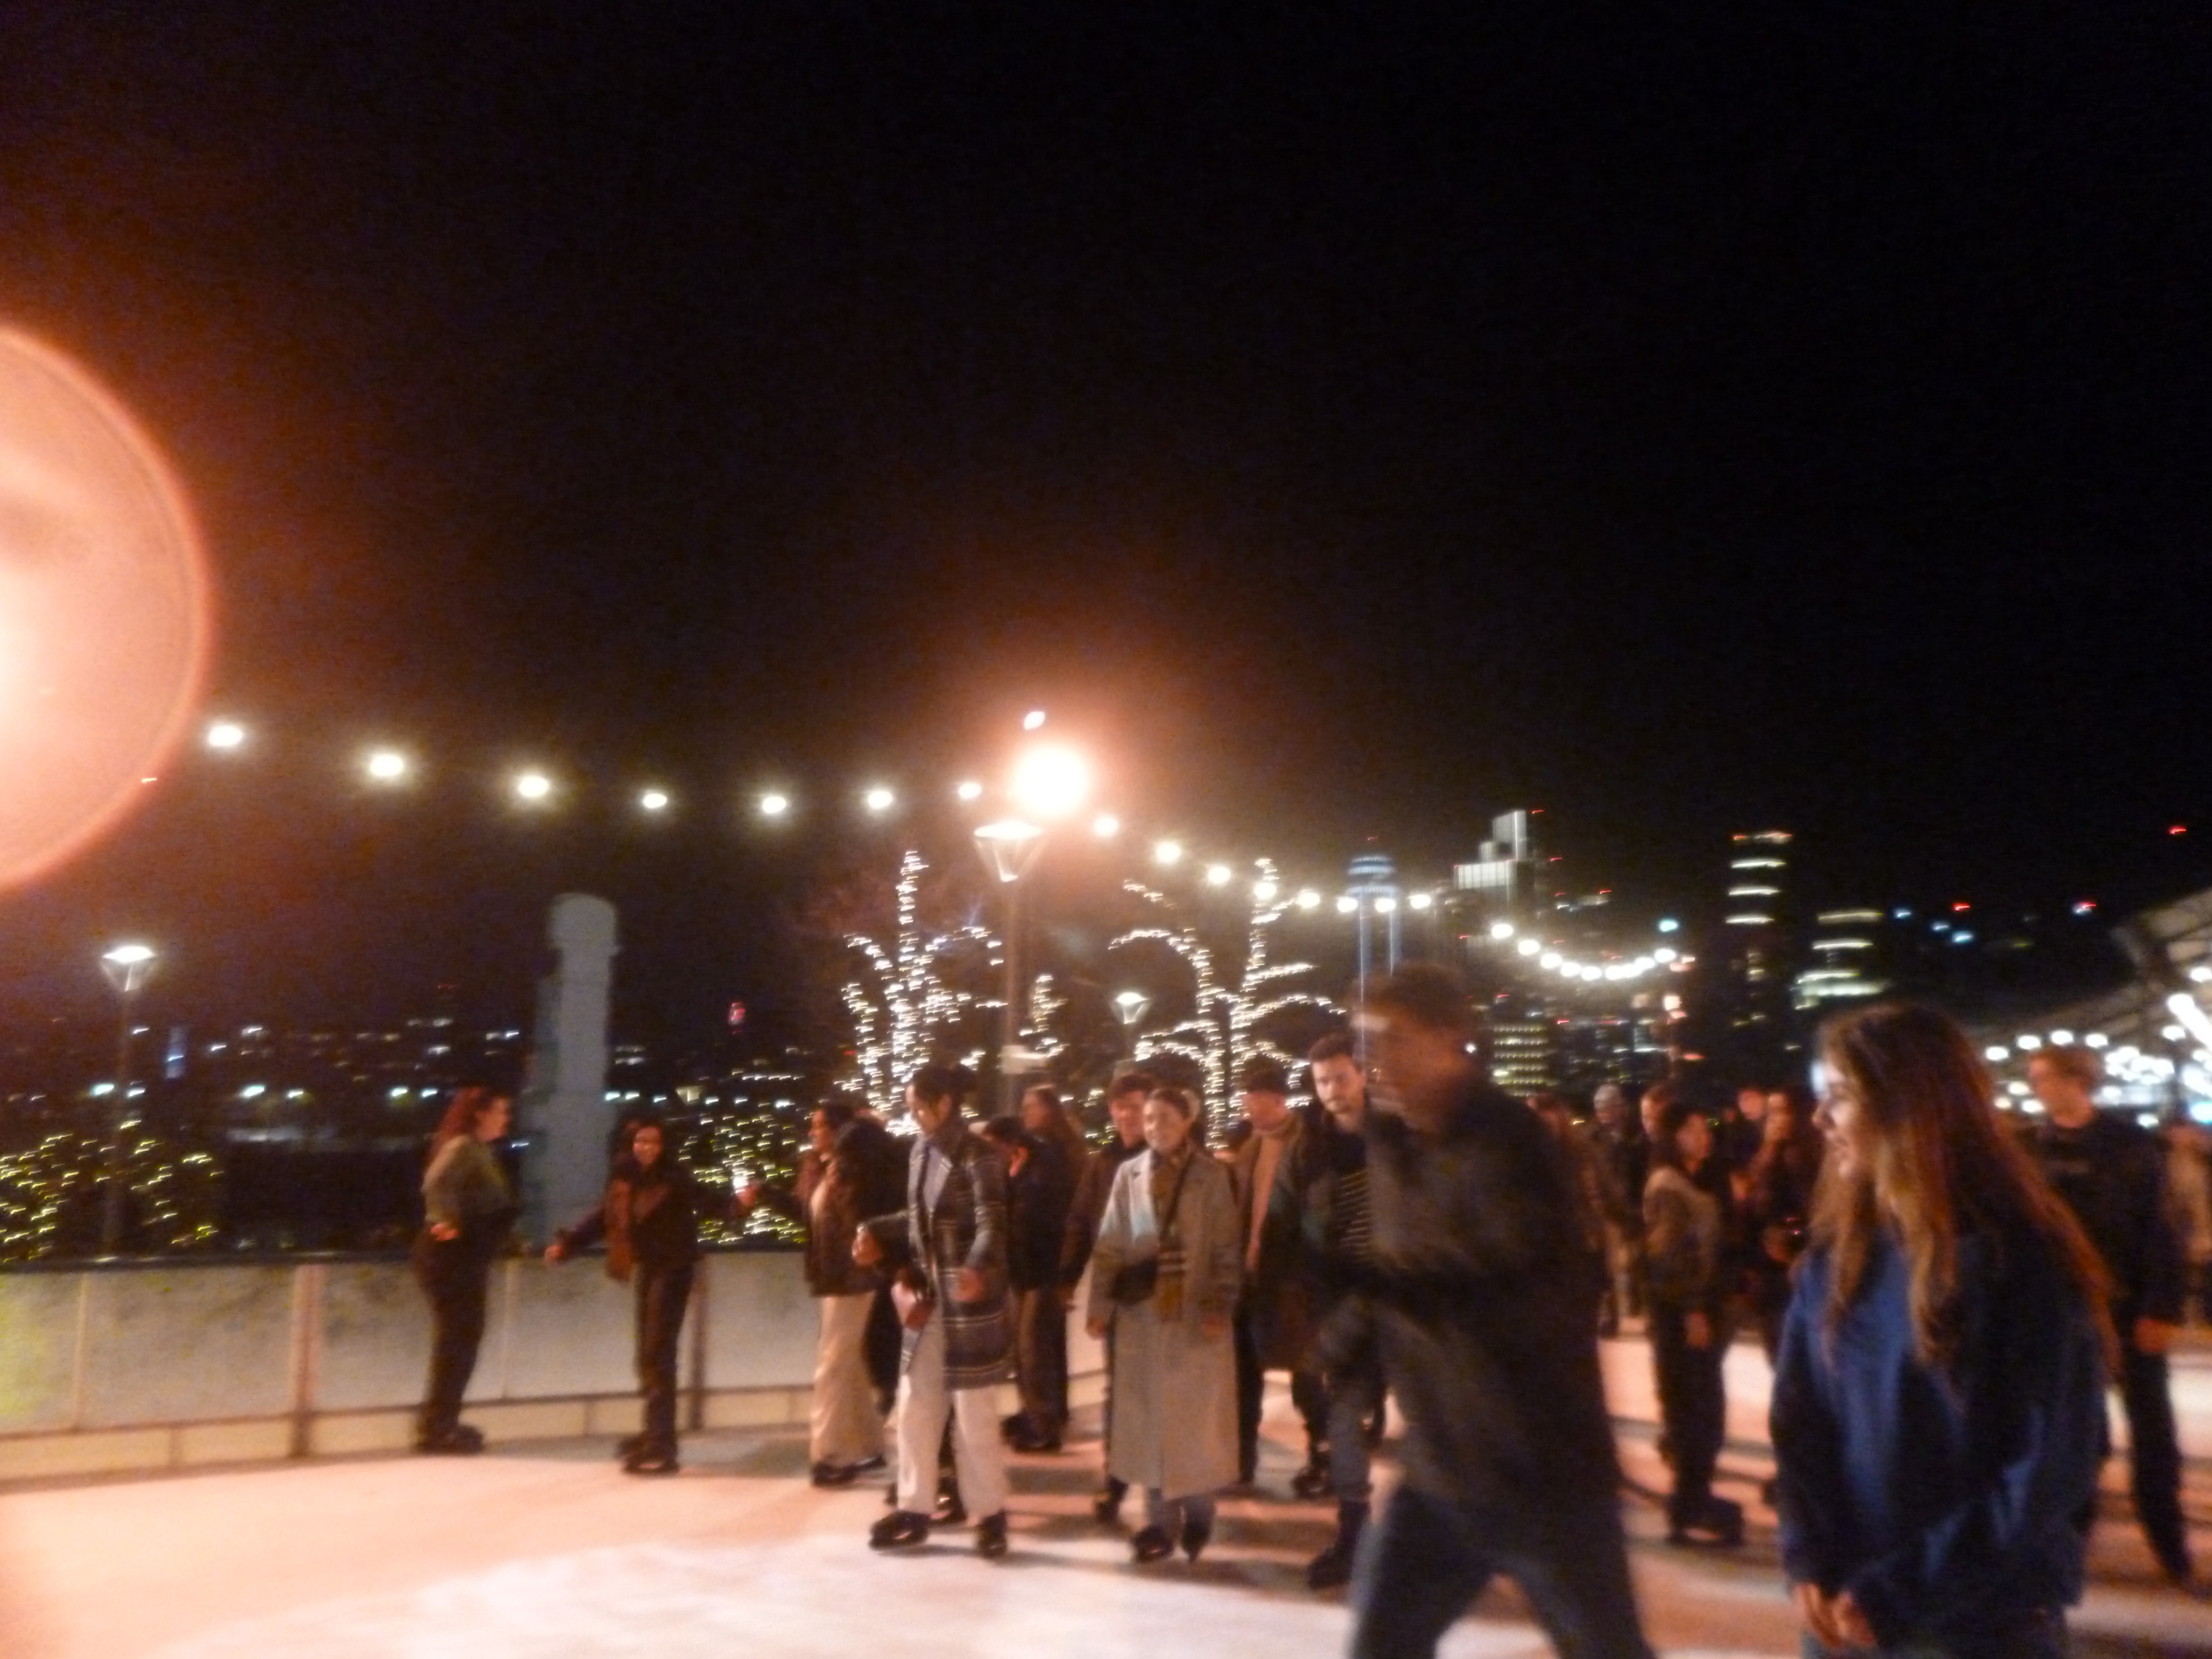
To conclude
Notes:
To conclude Artists act as quiet archivists of memory, translating fleeting experience into lasting form. “Art preserves more than beauty—it holds life, emotion, and memory. By treating art as an archive, we see how culture is carried through generations, reshaped but never lost.

