Slide 1
My plan and next steps for Unit5!
Melissini Motiti

Slide 2
Agenda
My understanding of unit 5
My plan and ideas
Steps to take for execution

Slide 3
My understanding of Unit 5 purpose
Submission is divided into 2 sections:
A body of chronicles showcasing how you represent collective memory of MAIP year 1.
Portfolio of Experimental work that will shine light on your challenges and how they help you evolve and progress your practise.
I’M FOCUSED ON EXPERIMENTATION!

Slide 4
PLAN FOR THE BODY OF CHRONICLES
Gather information from my Blog, notes and journal and analyse my notes and conversations with other students as class rep in order to give my take on our shared experiences.
Combine all information and form my interpretation of a timeline (chronology) of our experience and create a draft-storytelling-storyboard.
Create Subtitles for each Week and each Important event in order to create a base of chronology to each experience.
Give flesh to chronology through displaying our experience as a Visual Tapestry with a piece of illustration as each patch of the tapestry and its own explanation hanging from it/near it.

Slide 5
Through this Visual tapestry I aim to:
Represent our connection through this course even though we are divided geographically. Similarly to how different patches can create something beautiful when stitched together.
We are connected through thread and needle symbolic of our online interactions through the web.
I feel that our windows during our Teams meetings are perfectly represented through the patches in the tapestry and the chaotic feeling of joining this other-world to connect outside of our lived LIVE realities is perfectly encapsulated through the flow of a tapestry- book.

Slide 6
PLAN FOR THE PORTFOLIO OF EXPERIMENTAL WORK
Showcase experimentation and insights into how I battle challenges with my practise.
Show the behind the scenes of how I create the tapestry, patchwork(illustrations) and gather all information to create my final result.
Convey all failures and challenges and how they impacted each other and, in the end, how they taught a lesson and how they made the final project what it turned out to be.

Slide 7
Timeline
Gather all info
01
Draft storytelling of chronology through draft storyboard
02
Create and finish Tapestry
03
Gather and analyze all challenges phased to create Portfolio of “Failure”
04
Show final result to cohort & feedback.
05
During the execution of this timeline I plan to keep track and journal the process in order to have a portfolio of challenges (failures) and solutions that helped progress the tapestry (aka my practise) to its end.

Slide 8
Changes to the plan:
SURVEY
Through the process of experimenting and landing on ideas in a more secure way, I have decided to bin the idea of creating a survey.
Portfolio of Failure.
However, it will still be included in my portfolio of failure along with why I chose to not use it as part of the tools to create the Tapestry.

Slide 9
STEP.01: Gathering Information
Clip from my Blog where I kept track of every week’s progress, tutorials, interactions and thoughts.

Slide 10
Sub-titles and Captions
For this step the plan is to create subtitles for each week through my notes, and then decide which weeks were the most influential on my practice/ memory and visualize them for the tapestry.
Embodied Practice
Our place & Context
Lean & Be leaned on
listening in effective interviewing
Positionality & the Map

Slide 11
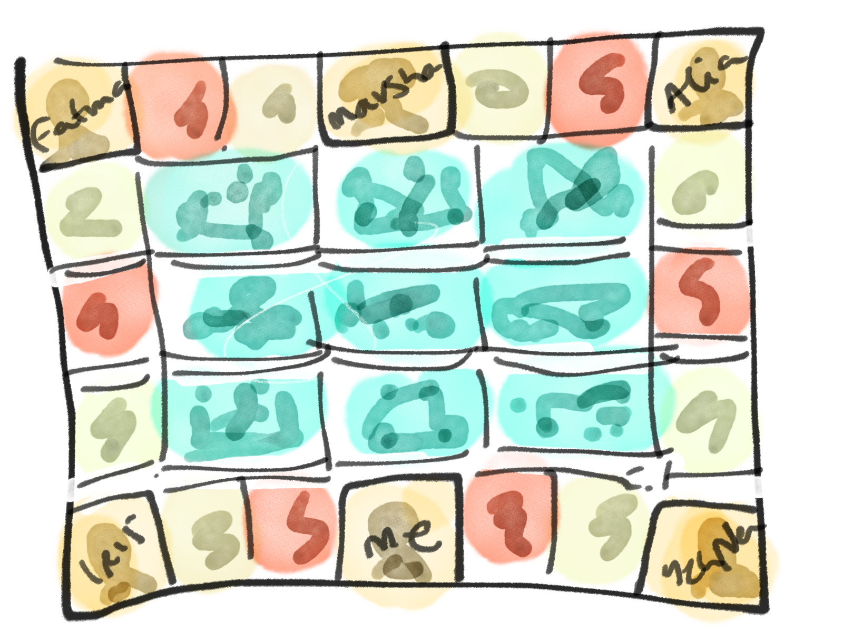
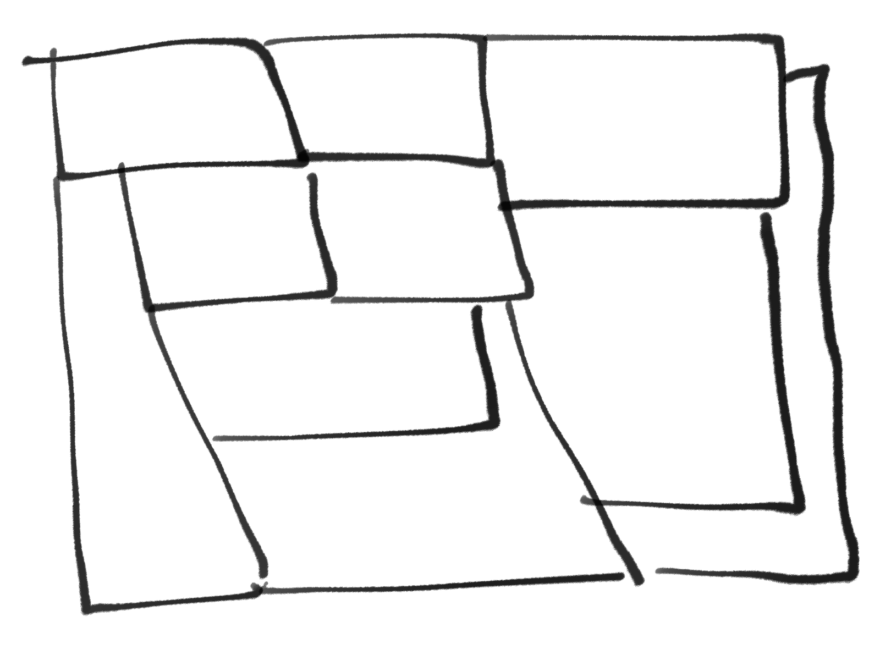
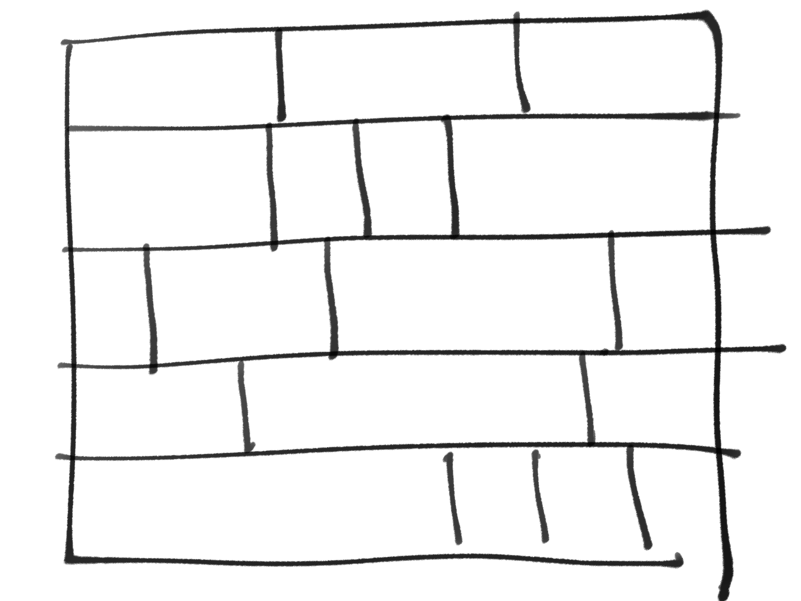
Step.02: Storyboarding
Ideas for layout
Creating a draft storyboard, attempting to tell the story of my experience.

Slide 12
STEP 03: Create & Finish Tapestry
UNDER CONSTRUCTION STILL

Slide 13
Thank you
Melissini Motiti
13/11/2024

